Slide 1
From Essence to Necessity via Identity
Qichen Yan

Slide 2
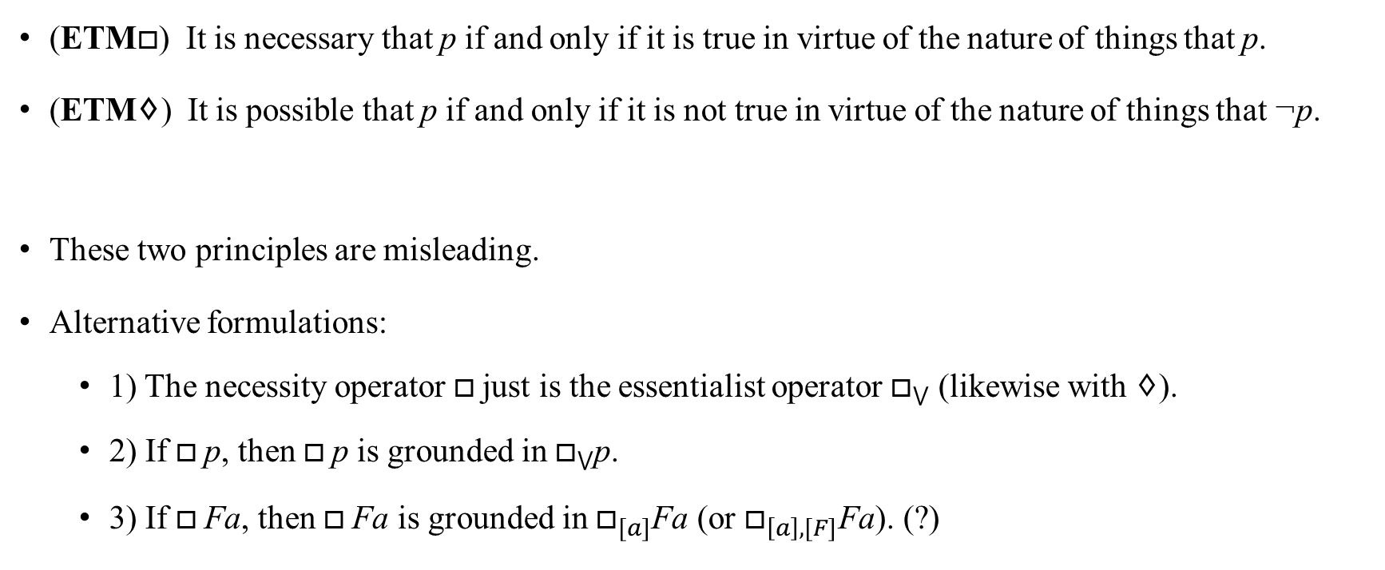
The reduction of necessity to essence
(ETM$□$) It is necessary that p if and only if it is true in virtue of the nature of things that p.
(ETM♢) It is possible that p if and only if it is not true in virtue of the nature of things that ¬p.
These two principles are misleading.
Alternative formulations:
1) The necessity operator $□$just is the essentialist operator $□_{⋁}$ (likewise with ♢).
2) If $□$p, then $□$p is grounded in $□_{⋁}$p.
3) If $□$Fa, then $□$Fa is grounded in $□_{[a]}$Fa (or $□_{\left[a\right],[F]}$Fa). (?)

Slide 3
Leech’s central claim
1) If one understands essence in terms of identity, then essence is not capable of generating necessity.
2) If one wants to defend an essentialist account of necessity, then one should not define essence in terms of identity.

Slide 4
Are all essential properties necessary properties?
(NP) If F is an essential property of x, then F is a necessary property of x.
If essence is defined through appealing to necessity, then NP is trivially true.
Conceptual/linguistic analysis doesn’t support NP.
Counterexamples to NP: 1) the “water” case; 2) the “cow” case.

Slide 5

Generalized Identity (GI)
$p≡q$
(For it to be the case that p is for it to be the case that q.)
$Fx≡_{x}Gx$
(For a thing to be F is for it to be G.)
$p≡_{x,y,...}q$
(For x,y,…to be such that p is for them to be such that q.)

Slide 6
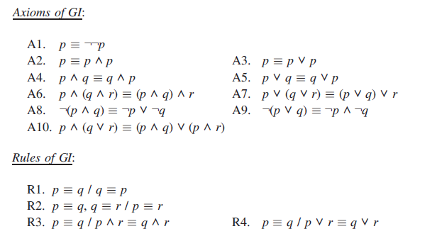
The logic of GI (I)
Reflexivity, Transitivity, Symmetry, Leibniz’s Law, and…

Slide 7
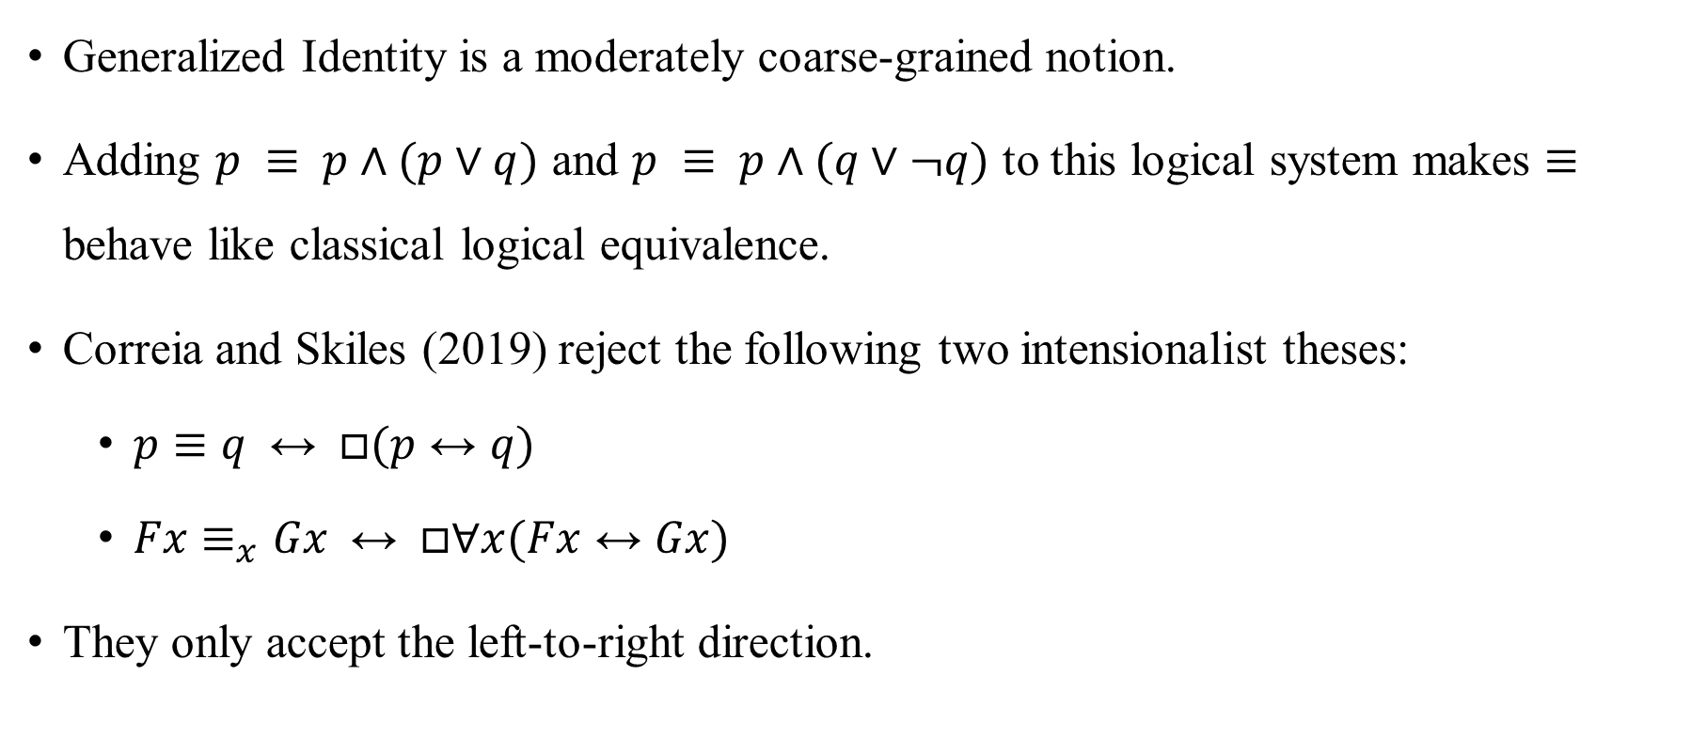
The logic of GI (II)
Generalized Identity is a moderately coarse-grained notion.
Adding $p ≡ p∧(p∨q)$ and $p ≡ p∧(q∨¬q)$ to this logical system makes $≡$ behave like classical logical equivalence.
Correia and Skiles (2019) reject the following two intensionalist theses:
$p≡q ↔ □(p↔q)$
$Fx≡_{x}Gx ↔ □∀x(Fx↔Gx)$
They only accept the left-to-right direction.

Slide 8
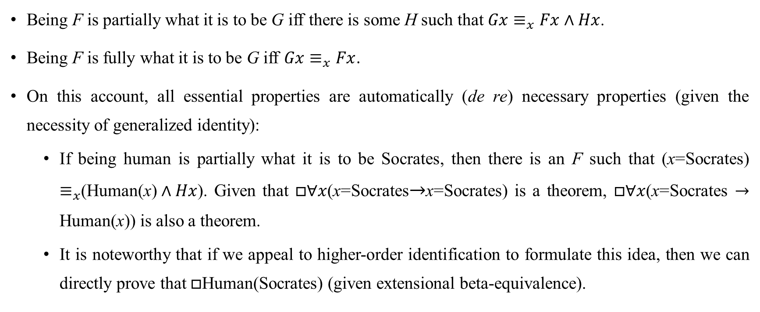
Defining essence in terms of generalized identity
Being F is partially what it is to be G iff there is some H such that $Gx≡_{x}Fx∧Hx$.
Being F is fully what it is to be G iff $Gx≡_{x}Fx$.
On this account, all essential properties are automatically (de re) necessary properties (given the necessity of generalized identity):
If being human is partially what it is to be Socrates, then there is an F such that (x=Socrates) $≡_{x}$(Human(x)$∧Hx$). Given that $□∀x$(x=Socrates$→$x=Socrates) is a theorem, $□∀x$(x=Socrates $→$ Human(x)) is also a theorem.
It is noteworthy that if we appeal to higher-order identification to formulate this idea, then we can directly prove that $□$Human(Socrates) (given extensional beta-equivalence).

Slide 9
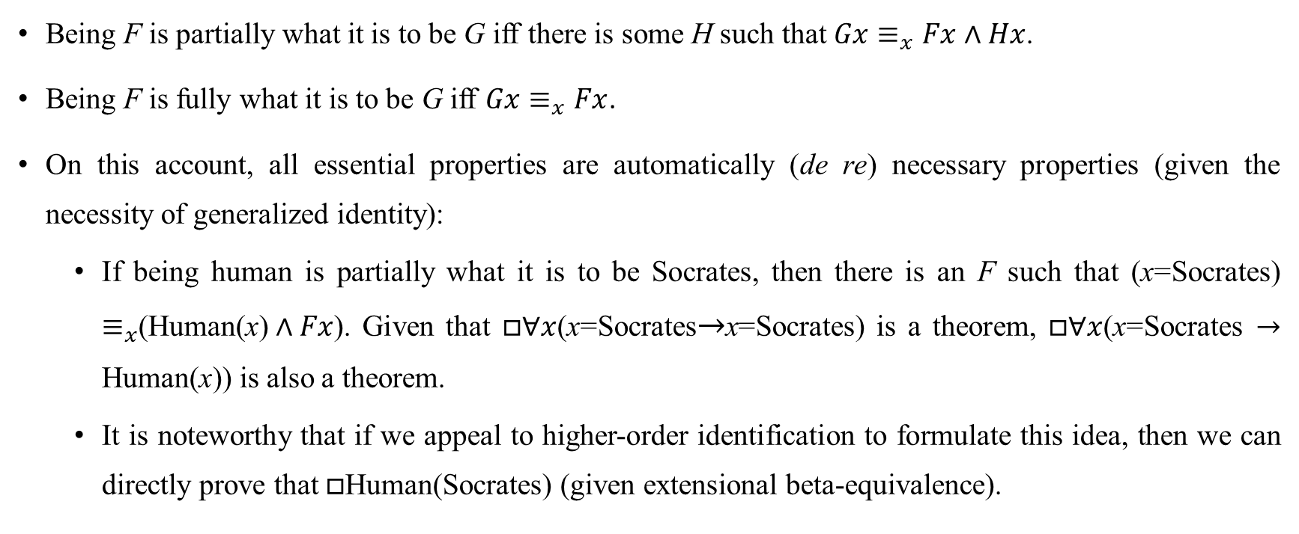
Defining essence in terms of generalized identity
Being F is partially what it is to be G iff there is some H such that $Gx≡_{x}Fx∧Hx$.
Being F is fully what it is to be G iff $Gx≡_{x}Fx$.
On this account, all essential properties are automatically (de re) necessary properties (given the necessity of generalized identity):
If being human is partially what it is to be Socrates, then there is an F such that (x=Socrates) $≡_{x}$(Human(x)$∧Fx$). Given that $□∀x$(x=Socrates$→$x=Socrates) is a theorem, $□∀x$(x=Socrates $→$ Human(x)) is also a theorem.
It is noteworthy that if we appeal to higher-order identification to formulate this idea, then we can directly prove that $□$Human(Socrates) (given extensional beta-equivalence).

Slide 10
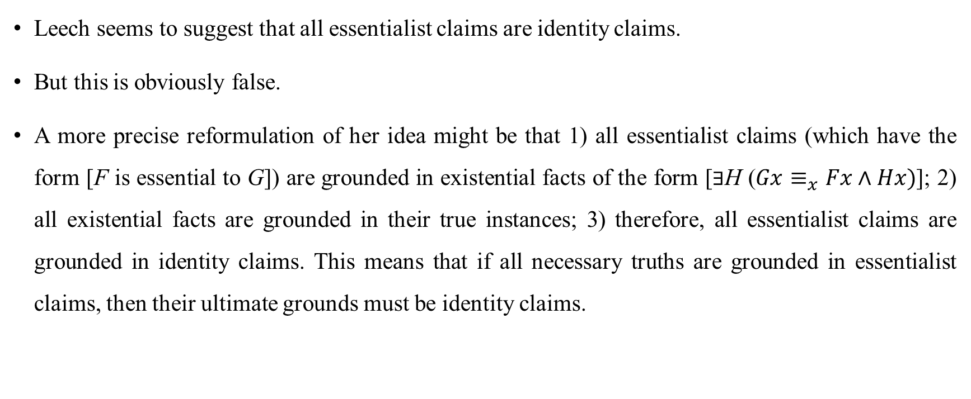
Essentialist claims and identity claims
Leech seems to suggest that all essentialist claims are identity claims.
But this is obviously false.
A more precise reformulation of her idea might be that 1) all essentialist claims (which have the form [F is essential to G]) are grounded in existential facts of the form [$∃$H ($Gx≡_{x}Fx∧Hx)$]; 2) all existential facts are grounded in their true instances; 3) therefore, all essentialist claims are grounded in identity claims. This means that if all necessary truths are grounded in essentialist claims, then their ultimate grounds must be identity claims.

Slide 11
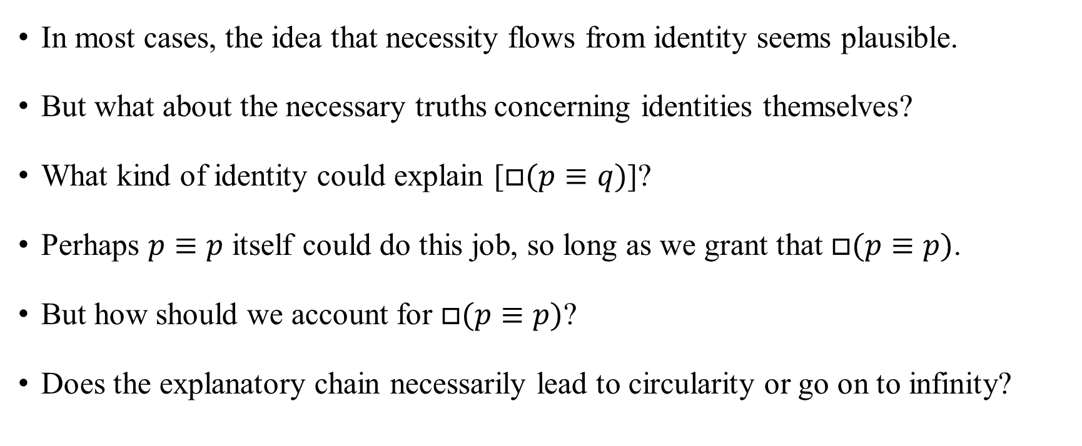
Explanations of necessary truths about identities
In most cases, the idea that necessity flows from identity seems plausible.
But what about the necessary truths concerning identities themselves?
What kind of identity could explain [$□(p≡q)$]?
Perhaps $p≡p$ itself could do this job, so long as we grant that $□(p≡p)$.
But how should we account for $□(p≡p)$?
Does the explanatory chain necessarily lead to circularity or go on to infinity?

Slide 12
Logical Necessity
What is logical necessity?
What is metaphysical necessity?

